Slide 1
10 Boolean logic
Introduction to logic gates and logic circuits

Slide 2
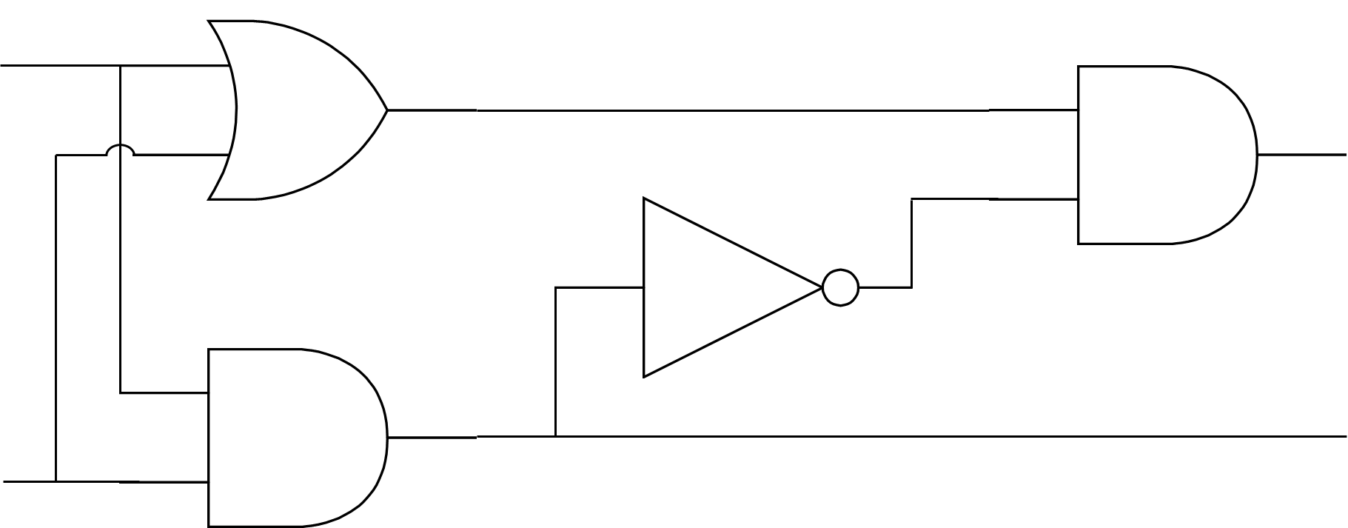
Half adder: An example of a logic diagram
A
D
OR
AND
S
E
NOT
AND
C
B
An example of a logic diagram created using a selection of AND, OR and NOT gates.
Also sometimes referred to as a circuit diagram or logic circuits.

Slide 3
Logic gates and truth tables: NOT
This is the symbol for a NOT gate.
A NOT gate reverses the input.
If input A is 0/FALSE/OFF, then the output is 1/TRUE/ON.
0
A
1
Truth table
A | NOT A
0 | 1
1

Slide 4
Logic gates and truth tables: NOT
This is the symbol for a NOT gate.
A NOT gate reverses the input.
If input A is 1/TRUE/ON, then the output is 0/FALSE/OFF.
1
A
0
Truth table
A | NOT A
0 | 1
1 | 0

Slide 5
Logic gates and truth tables: AND
This is the symbol for an AND gate.
An AND gate output is TRUE if both of its inputs are TRUE – otherwise, the output is FALSE.
If input A is 0 and B is 0, the output is 0.
0
A
0
0
B
Truth table
A | B | A AND B
0 | 0 | 0
0 | 1
1 | 0
1 | 1

Slide 6
Logic gates and truth tables: AND
This is the symbol for an AND gate.
An AND gate output is TRUE if both of its inputs are TRUE – otherwise, the output is FALSE.
If input A is 0 and B is 1, the output is 0.
0
A
0
1
B
Truth table
A | B | A AND B
0 | 0 | 0
0 | 1 | 0
1 | 0
1 | 1

Slide 7
Logic gates and truth tables: AND
This is the symbol for an AND gate.
An AND gate output is TRUE if both of its inputs are TRUE – otherwise, the output is FALSE.
If input A is 1 and B is 0, the output is 0.
1
A
0
0
B
Truth table
A | B | A AND B
0 | 0 | 0
0 | 1 | 0
1 | 0 | 0
1 | 1

Slide 8
Logic gates and truth tables: AND
This is the symbol for an AND gate.
An AND gate output is TRUE if both of its inputs are TRUE – otherwise, the output is FALSE.
If input A is 1 and B is 1, the output is 1.
1
A
1
1
B
Truth table
A | B | A AND B
0 | 0 | 0
0 | 1 | 0
1 | 0 | 0
1 | 1 | 1

Slide 9
Logic gates and truth tables: OR
This is the symbol for an OR gate.
An OR gate output is TRUE if at least one of its inputs is TRUE – otherwise, the output is FALSE.
If input A is 0 and B is 0, the output is 0.
0
A
0
B
0
Truth table
A | B | A OR B
0 | 0 | 0
0 | 1
1 | 0
1 | 1

Slide 10
Logic gates and truth tables: OR
This is the symbol for an OR gate.
An OR gate output is TRUE if at least one of its inputs is TRUE – otherwise, the output is FALSE.
If input A is 0 and B is 1, the output is 1.
0
A
1
B
1
Truth table
A | B | A OR B
0 | 0 | 0
0 | 1 | 1
1 | 0
1 | 1

Slide 11
Logic gates and truth tables: OR
This is the symbol for an OR gate.
An OR gate output is TRUE if at least one of its inputs is TRUE – otherwise, the output is FALSE.
If input A is 1 and B is 0, the output is 1.
1
A
1
B
0
Truth table
A | B | A OR B
0 | 0 | 0
0 | 1 | 1
1 | 0 | 1
1 | 1

Slide 12
Logic gates and truth tables: OR
This is the symbol for an OR gate.
An OR gate output is TRUE if at least one of its inputs is TRUE – otherwise, the output is FALSE.
If input A is 1 and B is 1, the output is 1.
1
A
1
B
1
Truth table
A | B | A OR B
0 | 0 | 0
0 | 1 | 1
1 | 0 | 1
1 | 1 | 1

Slide 13
Logic gates and truth tables: NAND
This is the symbol for a NAND gate.
A NAND gate is like putting an AND and a NOT gate together. It effectively reverses the output from an AND gate.
If input A is 0 and B is 0, the output is 1.
0
A
1
0
B
Truth table
A | B | A NAND B
0 | 0 | 1
0 | 1
1 | 0
1 | 1
AND + NOT = NAND

Slide 14
Logic gates and truth tables: NAND
This is the symbol for a NAND gate.
A NAND gate is like putting an AND and a NOT gate together. It effectively reverses the output from an AND gate.
If input A is 0 and B is 1, the output is 1.
0
A
1
1
B
Truth table
A | B | A NAND B
0 | 0 | 1
0 | 1 | 1
1 | 0
1 | 1
AND + NOT = NAND

Slide 15
Logic gates and truth tables: NAND
This is the symbol for a NAND gate.
A NAND gate is like putting an AND and a NOT gate together. It effectively reverses the output from an AND gate.
If input A is 1 and B is 0, the output is 1.
1
A
1
0
B
Truth table
A | B | A NAND B
0 | 0 | 1
0 | 1 | 1
1 | 0 | 1
1 | 1
AND + NOT = NAND

Slide 16
Logic gates and truth tables: NAND
This is the symbol for a NAND gate.
A NAND gate is like putting an AND and a NOT gate together. It effectively reverses the output from an AND gate.
If input A is 1 and B is 1, the output is 0.
1
A
0
1
B
Truth table
A | B | A NAND B
0 | 0 | 1
0 | 1 | 1
1 | 0 | 1
1 | 1 | 0
AND + NOT = NAND

Slide 17
Logic gates and truth tables: NOR
This is the symbol for a NOR gate.
A NOR gate is like putting an OR and a NOT gate together. It effectively reverses the output from a OR gate.
If input A is 0 and B is 0, the output is 1.
0
A
1
B
0
Truth table
A | B | A NOR B
0 | 0 | 1
0 | 1
1 | 0
1 | 1
OR + NOT = NOR

Slide 18
Logic gates and truth tables: NOR
This is the symbol for a NOR gate.
A NOR gate is like putting an OR and a NOT gate together. It effectively reverses the output from a OR gate.
If input A is 0 and B is 1, the output is 0.
0
A
0
B
1
Truth table
A | B | A NOR B
0 | 0 | 1
0 | 1 | 0
1 | 0
1 | 1
OR + NOT = NOR

Slide 19
Logic gates and truth tables: NOR
This is the symbol for a NOR gate.
A NOR gate is like putting an OR and a NOT gate together. It effectively reverses the output from a OR gate.
If input A is 1 and B is 0, the output is 0.
1
A
0
B
0
Truth table
A | B | A NOR B
0 | 0 | 1
0 | 1 | 0
1 | 0 | 0
1 | 1
OR + NOT = NOR

Slide 20
Logic gates and truth tables: NOR
This is the symbol for a NOR gate.
A NOR gate is like putting an OR and a NOT gate together. It effectively reverses the output from a OR gate.
If input A is 1 and B is 1, the output is 0.
1
A
0
B
1
Truth table
A | B | A NOR B
0 | 0 | 1
0 | 1 | 0
1 | 0 | 0
1 | 1 | 0
OR + NOT = NOR

Slide 21
Logic gates and truth tables: XOR
This is the symbol for an XOR gate.
An XOR gate output is TRUE if one and only one of its inputs is TRUE – otherwise, the output is FALSE.
If input A is 0 and B is 0, the output is 0.
0
A
0
B
0
Truth table
A | B | A XOR B
0 | 0 | 0
0 | 1
1 | 0
1 | 1

Slide 22
Logic gates and truth tables: XOR
This is the symbol for an XOR gate.
An XOR gate output is TRUE if one and only one of its inputs is TRUE – otherwise, the output is FALSE.
If input A is 0 and B is 1, the output is 1.
0
A
1
B
1
Truth table
A | B | A XOR B
0 | 0 | 0
0 | 1 | 1
1 | 0
1 | 1

Slide 23
Logic gates and truth tables: XOR
This is the symbol for an XOR gate.
An XOR gate output is TRUE if one and only one of its inputs is TRUE – otherwise, the output is FALSE.
If input A is 1 and B is 0, the output is 1.
1
A
1
B
0
Truth table
A | B | A XOR B
0 | 0 | 0
0 | 1 | 1
1 | 0 | 1
1 | 1

Slide 24
Logic gates and truth tables: XOR
This is the symbol for an XOR gate.
An XOR gate output is TRUE if one and only one of its inputs is TRUE – otherwise, the output is FALSE.
If input A is 1 and B is 1, the output is 0.
1
A
0
B
1
Truth table
A | B | A XOR B
0 | 0 | 0
0 | 1 | 1
1 | 0 | 1
1 | 1 | 0

Slide 25

Logic gates and truth tables: Summary
A
A
A
NOT
AND
OR
B
B
A | B | A AND B
0 | 0 | 0
0 | 1 | 0
1 | 0 | 0
1 | 1 | 1
A | B | A OR B
0 | 0 | 0
0 | 1 | 1
1 | 0 | 1
1 | 1 | 1
A | NOT A
0 | 1
1 | 0
A
A
A
B
XOR
NAND
NOR
B
B
A | B | A XOR B
0 | 0 | 0
0 | 1 | 1
1 | 0 | 1
1 | 1 | 0
A | B | A AND B
0 | 0 | 1
0 | 1 | 1
1 | 0 | 1
1 | 1 | 0
A | B | A OR B
0 | 0 | 1
0 | 1 | 0
1 | 0 | 0
1 | 1 | 0

Slide 26
OR
How to remember the different logic gate symbols

Slide 27
10 Boolean logic | Introduction to logic gates and logic circuits
CAMBRIDGE IGCSE (0478/0984)
How to remember the different logic gate symbols
OR
XOR

Slide 28
AND
10 Boolean logic | Introduction to logic gates and logic circuits
CAMBRIDGE IGCSE (0478/0984)
How to remember the different logic gate symbols

Slide 29
10 Boolean logic | Introduction to logic gates and logic circuits
CAMBRIDGE IGCSE (0478/0984)
How to remember the different logic gate symbols
NOT

Slide 30


